Slide 1
Requirements Engineering

Slide 2
Introduction
What does Plan-and-Document do instead of
User stories?
Points?
Velocity?
How does a project manager estimate costs?
Make a Schedule?

Slide 3

Equivalents
Requirements Elicitation
Requirements Documentation
Cost Estimation
Scheduling and Monitoring Progress
Change Management for Requirements, Cost, andSchedule
Ensuring Implementation Matches Requirement Features
Risk Analysis and Management

Slide 4
Requirements Engineering
"The hardest single part of building a software system is deciding what to build. No part of the work so cripples the resulting system if done wrong. No other part is more difficult to rectify later" --Fred Brooks
Without RE, the resulting software has a high probability of not meeting customer's needs.

Slide 5
Stakeholders
A stakeholder is anyone who has a stake in the successful outcome of the project

Slide 6
Major Requirements Engineering Activities
Elicitation
Analysis
Specification
Review and Validations
Agreement and Acceptance

Slide 7
Requirements Engineering Activities
Requirements
Definition
Requirements
Elicitation
Requirements
Specification
Requirements
Analysis
Requirements
Prototyping
Requirements
Review
Requirements
Agreement and
Acceptance

Slide 8
Why is RE important?
Basis for design and implementation activities
Used to create test cases and test scenarios
Needed to control potential scope-creep
Used to create user training material, marketing material, and documents for support and maintenance
Helps with project management

Slide 9
Requirements

Slide 10
Requirements
Requirements are the descriptions of what the system should do.
Types of requirements
User requirements
System requirements
Functional requirements
Non-functional requirements

Slide 11
Quantifying Requirements
Avoid vague and unverifiable requirements
Particularly important for nonfunctional requirements

Slide 12
Metrics
Speed
Size
Ease of use
Reliability
Robustness
Portability

Slide 13
Requirements Traceability
Capability to trace a requirements is required
Trace
Source of requirements
Links to later steps
We also need to link requirements to other pre-requisite requirements.

Slide 14
Elicitation

Slide 15
Elicitation
Need to seek out the business and management perceptions and goals for the software project
The application domain
Business opportunity and needs
The services to be provided by the system
Hardware constraints
Scope
Success Factor
User characteristics
Involves working with different kinds of people
What NOT how

Slide 16
Potential problems
Scope problems
Understanding problems
Volatility problems

Slide 17
Interviews
Interviews are an important part of the RE process
Can be formal or informal
Potential pitfalls
Jargon
Domain knowledge
Information from interviews supplement other information about the system from documentation.

Slide 18
Ethnography
Observational technique
Helps discover implicit system requirements that reflect the actual ways that people work

Slide 19
Question 1
These type of requirements specify the services the system is expected to provide to system users and the constraints under which it must operate.
User requirements
System requirements
Functional requirements
Non-functional requirements

Slide 20
Question 2
"The system must provide user response time of less than 0.5 seconds" is an example of what type of requirement?
Functional
Non-functional

Slide 21
Question 3
The only method of eliciting requirements is interviewing stakeholders
True
False

Slide 22
Analysis
Notes:
start here

Slide 23
Analysis Process
Requirements classification and organization
Requirements prioritization and negotiation
Requirements specification

Slide 24
Scenarios
Descriptions of example interaction systems
Scenario starts with an outline of the interaction
Details are added
starting state
the normal flow of events
potential problems
concurrent activities
ending state

Slide 25
Use of graphical models
Facilitate discussion
Document an existing system
Detailed system description that can be used to generate a system implementation

Slide 26
UML Use Cases
Scenario based technique in UML
A set of use cases should describe all possible interactions with the system.
Use case methodology and notation identifies:
Basic functionalities
Pre-conditions
Flow of events
Post-conditions
Error conditions and alternative flows

Slide 27
Use-Case Analysis
Identify actors
Identify all activities related to actors
Determine system boundaries

Slide 28
Requirements Definition using Use Case Diagram
Add Course
Register For Section
Add Section
Student
Choose Section
Add Student
Registrar

Slide 29
Transfer-data use case

Slide 30
Use cases involving the Medical Receptionist ROLE

Slide 31
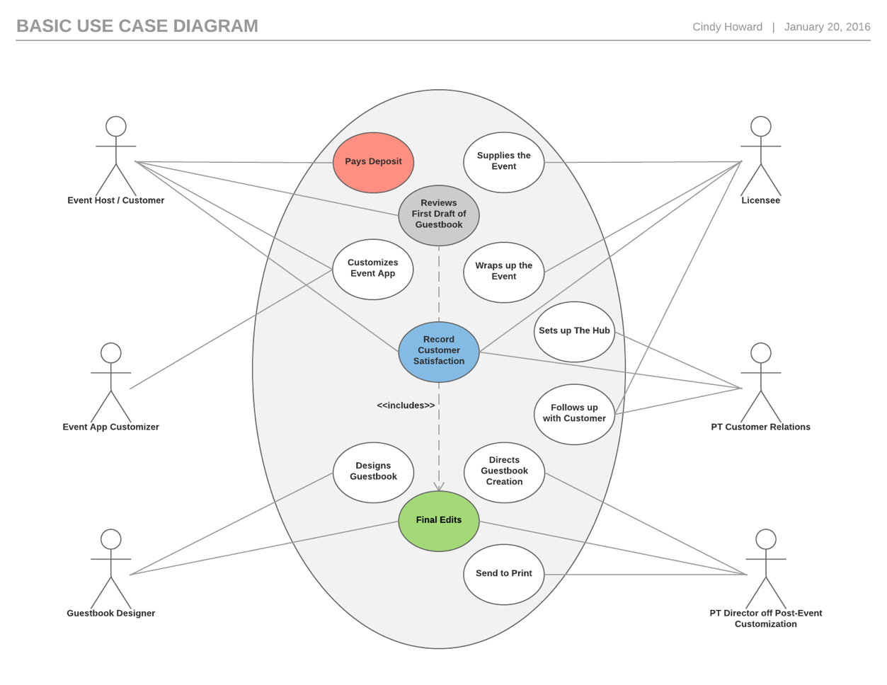
Use Case Diagram

Slide 32
Use Case Description
Use case diagrams alone are not detailed enough
Need to further descriptions of the requirements:
Functional details
Pre-conditions
Post-conditions
Non-functional characteristics
Alternative paths
UI

Slide 33
Sequence diagram
Shows the sequence of interactions that take place during a particular use case.
The objects and actors involved are listed along the top of the diagram.
Interactions between objects are indicated by arrows.

Slide 34
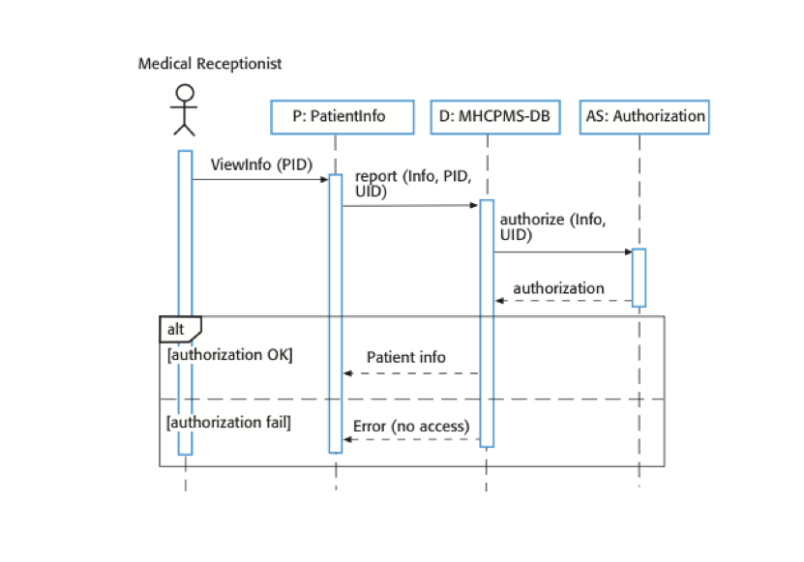
Sequence diagram example

Slide 35
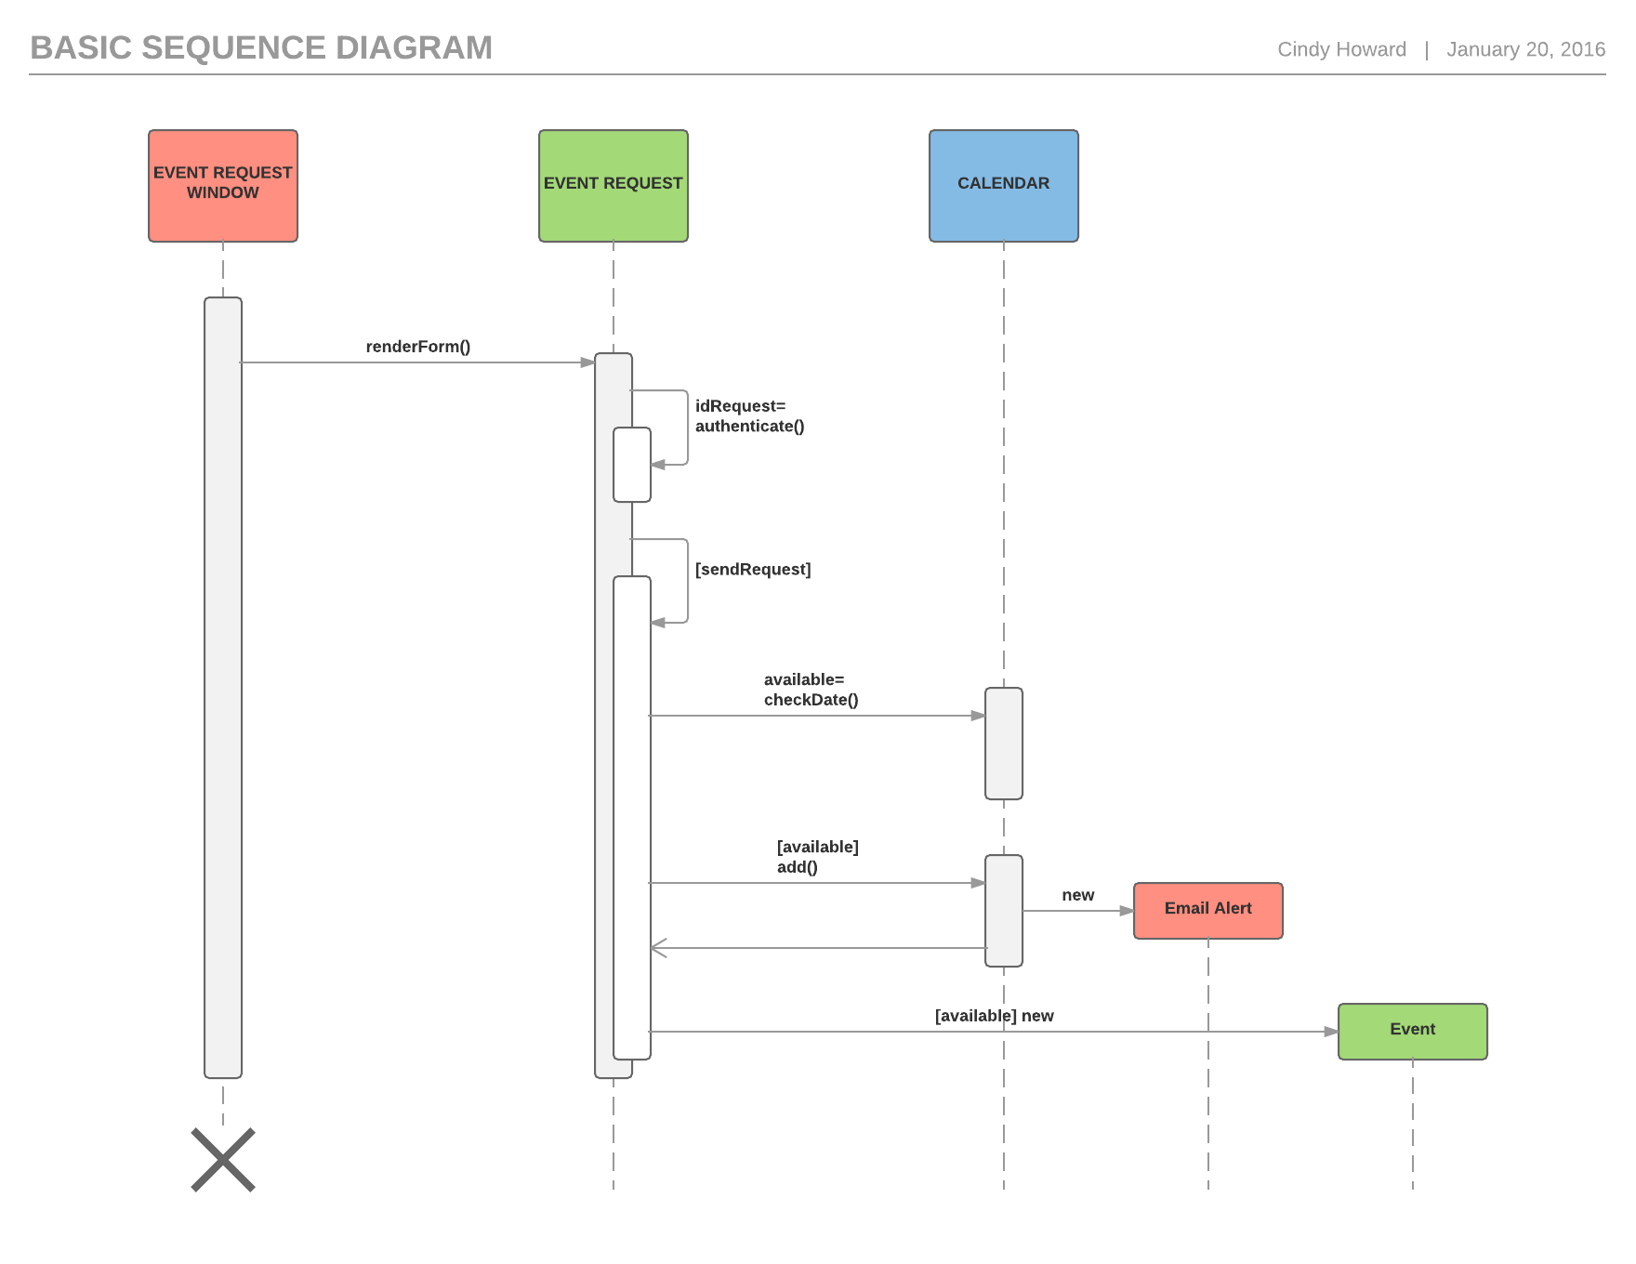

Slide 36
UML diagrams
Use case diagrams show the interactions between a system and its environment.
Sequence diagrams show interactions between actors and the system and between system components.

Slide 37
Tools for Creating UML Diagrams
Visio
LucidChart

Slide 38
Question 4
Use case diagram actors include
users
other systems
hardware
All of the above

Slide 39
Question 5
A set of use cases should describe all possible interactions with the system
True
False

Slide 40
Question 6
Use case diagrams describe
Tasks that involve external interaction with the system
The sequence of interactions that take place
Pre-conditions and post-conditions
All of the above

Slide 41
In-Class Exercise
Using your knowledge of how an ATM is used, develop a set of use cases that could serve as a basis for understanding the requirements of an ATM system. Be sure to include use cases for exceptional cases.
Write a set of non-functional requirements for an ATM, making sure to quantify the requirements.

Slide 44
Requirements Prioritization
Need to prioritize the requirements to satisfy limitations
Some criteria:
Current user/customer demands or needs
Competition and current market condition
Anticipated future and new customer needs
Sales advantages
Existing critical problems in current product

Slide 45
A Simple Requirements Prioritization List
Brief Req.
description
Req. source
Req. priority
Req. Status
Req. #
One page
query must
respond in
less than
1 second
A Major
account
Marketing
Rep.
Priority 1
# 1
Accepted for
this release
Help text
must be
field sensitive
Large account
users
Priority 2
Postponed
For next
release
# 2

Slide 46
Requirements Prioritization Process
Comparing the requirements and placing them in some order relative to each other.
Can be done informally or formally

Slide 47
Analytical Hierarchical Process (AHP) example
 | Req 1 | Req 2 | Req 3
Req 1 | 1 | 2 | 3
Req 2 | 1/2 | 1 | 2
Req 3 | 1/3 | 1/2 | 1
Requirements Prioritization
Req. 1 = 1.62 / 3 = 54%
Req. 2 = .89 / 3 = 30%
Req. 3 = .49 / 3 = 16%
1.83
3.5
6.0
 | Req 1 | Req 2 | Req 3
Req 1 | .55 | .57 | .5
Req 2 | .27 | .29 | .33
Req 3 | .18 | .14 | .17
1.62
.89
.49

Slide 48
Requirements definition, prototyping and review
May need more detail
Following activities are performed
Requirements definition
Requirements prototyping
Requirements reviewing

Slide 49
Definitions
May be written in different forms:
Simple Input/Process/Output (I-P-0) descriptions
Dataflow diagrams (DFD)
Entity Relations diagram (ERD)
Use Case Diagram (UML)

Slide 50
Requirement Definition Using Input-Process-Output Diagram Form
Requirement Number | Input | Process | Output
#12 Customer Order Entry | Items by type and quantity Submit request | Accept the items and respective quantities | Display acceptance message Ask for confirmation message

Slide 51
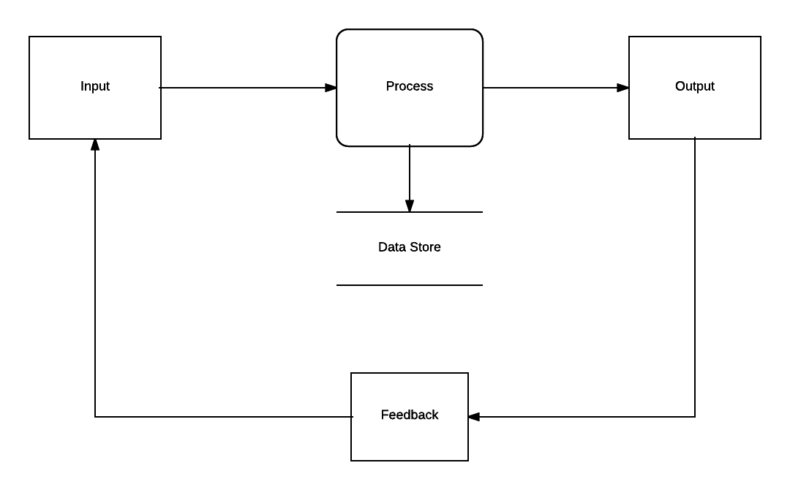
Input-Process-Output Diagram

Slide 52
Syntax of Data Flow Diagram (DFD)
symbols
semantics
Customer
source or destination of data
Process XXX
process or function
data store/file
Ordered Data
flow of data

Slide 53
Requirements Definition using DFD
Captures functionality, business flow, data
Inventory Info.
Package Data
Product avail.
Info.
Packaging
details
Order Processing
Shipping
Instruct.
Packaging
Orders
Customer
Invoice
Customer credit,
address, etc.
Customer Info DB
Notes:
4

Slide 54
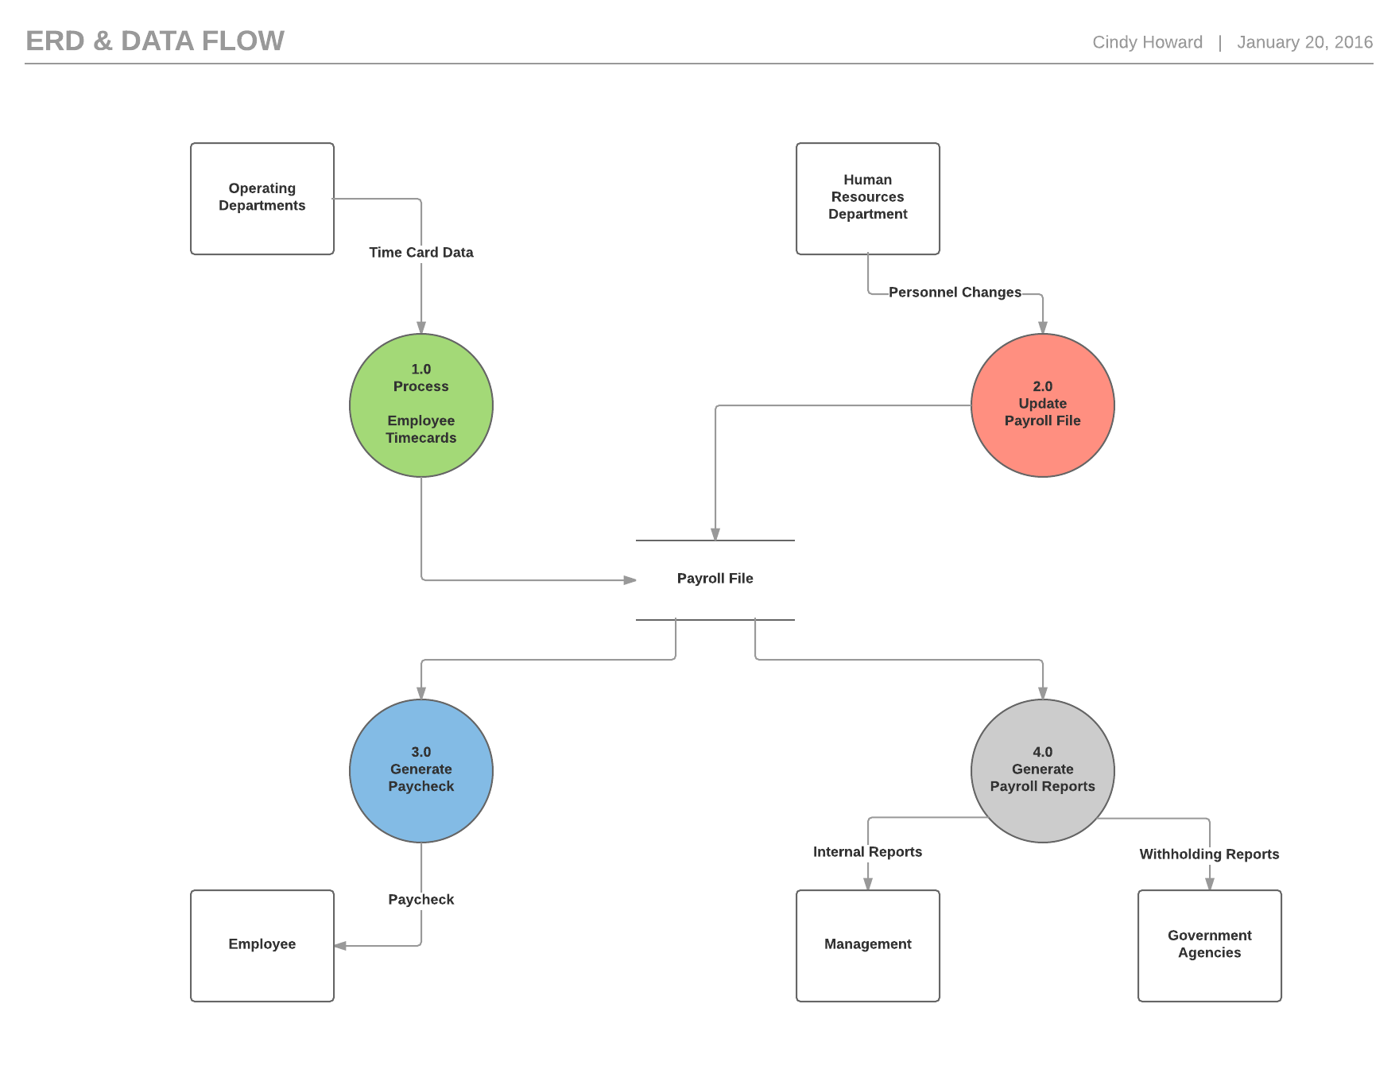
Data Flow Diagram

Slide 55
Entity- Relation-Diagram (ERD)
order
1
includes
m
items
Cardinality: specifies the number of occurrences of entities
customer
order
Modality: specifies the necessities of relationship to exist
Captures relations among data

Slide 56
Entity and Attributes
Graphical form
Tabular form
Employee
Employee
- Name
- Age
Address
Name
Age
- Address
- Street
- City
- State
- Zip
Street
City
State
Zip
Captures relations among data

Slide 57
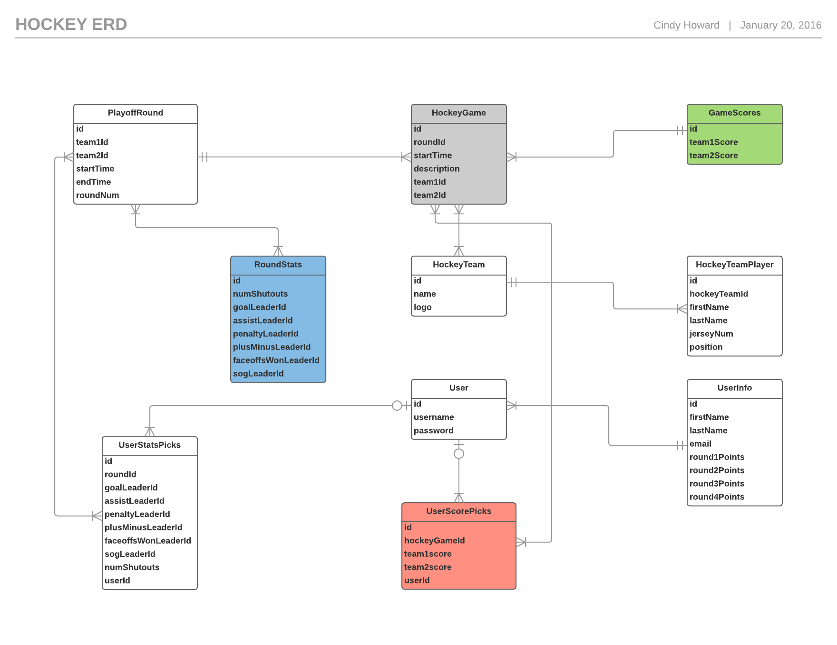
Entity-Relation-Diagram

Slide 58
Requirements Prototyping
Requirements prototyping mostly address the UI part of the requirement in terms of:
Visual looks
Flow
The prototyping may be performed in one of the two modes:
Low fidelity
High fidelity

Slide 59
Specification

Slide 60
Requirements Specification
Process of recording user and system requirements in requirements specification document
Only include external behavior
Various methods for documenting
Requirements documents can vary in amount of detail
IEEE has a standard that contains guidelines for the 3 major sections of a requirements specification document.
Introduction
High Level description
Detailed descriptions

Slide 61
Detailed Description
Details of each functionality (input-out-process)
Descriptions of interfaces
Detailed description of performance requirements
List of design constraints
Additional descriptions of attributes including security, availability, and recoverability
Any other unique requirements

Slide 62
Validation
Examine specifications to
ensure that all software requirements have been stated unambiguously
that inconsistencies, omissions and errors have been detected and correct
that work products conforms to the established standards
Types of checks
Validity
Consistency
Completeness
Realism
Verifiability

Slide 63
Validation Techniques
Technical review
Prototyping
Test-case generation

Slide 64
Acceptance

Slide 65
Requirements Sign Off
Serves as a milestone marker
Formally exits a phase of software of engineering
Baseline

Slide 66
Question 7
The following is used for prioritizing requirements
DFD
AHP
ERD
UML

Slide 67
Question 8
Requirements documents
Include only natural language descriptions
Are always very detailed
Include external behavior
Record user and system requirements

Slide 68
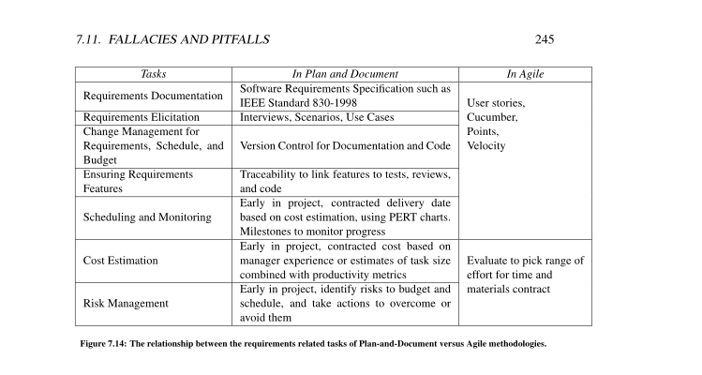
P and D vs. Agile Requirements and Schedule/Cost Estimation

